Slide 1
Dolvin Elementary
PTA Room Parent Orientation

Slide 2
PTA Room Parent Coordinator
Randi Truelove
rtruelove@gmail.com

Slide 3
Agenda
Responsibilities
General Guidelines
Communication
Classroom Activity Fund
Classroom Parties & Activities
Teacher Gifts
Other Policies & Procedures

Slide 4
Volunteer Registration
Please use below link to take the required volunteer safety course from Fulton County. Once you have completed the registration, it is good for two years. It can take up to 48 hours for it to be cleared in the system.
https://www.fultonschools.org/volunteer
All volunteers will need to complete this, so please communicate this to your party volunteers and any other classroom volunteers.

Slide 5
What does a Room Parent do?
Collects and manages financial responsibilities of classroom activity fund
Communicates information to parents as needed regarding classroom-related information
Coordinates classroom volunteers
Organizes teacher appreciation activities
Responds to and organizes assistance for ad hoc requests by the teacher
1.
2.
3.
4.
5.

Slide 6
General Guidelines
Please do not interrupt class time.
Wear a Visitor Badge at all times.
For classroom activities, make other arrangements for siblings.
Prearrange any meeting times with the teacher.
Ask the teacher what works best for him/her.

Slide 7
Communication

Slide 8
Communicating with Teachers
Communicate with the teacher about what is needed and then communicate with the Support Parent(s) in your room about how they can help.
Obtain a class roster for your class (including e-mail addresses) from the teacher.
Use email for most communication.
Items for teacher’s mailboxes should be left with the front office staff.

Slide 9
Communicating with Parents
Introduce yourself to the class parents via e-mail using the pre-approved letter from your Room Parent Coordinator.
Use SignupGenius for coordinating parent volunteers: www.signupgenius.com
Any formal communication outside of the typical room parent communication (preapproved intro letter at beginning of the year, asking for party items, asking for party volunteers, organizing teacher appreciation, communicating about teacher birthday books, asking for volunteers for activities at request of teacher, etc.) should be approved by Ms. Cooke. If you are unclear about whether your communication needs approval, check with the Room Parent Coordinator.
If you need communication approved, email Ms. Cooke at cookeK1@fultonschools.org and cc Denise Fasone at fasone@fultonschools.org. Please allow 48 hours for approval.

Slide 10
Classroom Activity Fund

Slide 11
What is the Classroom Activity Fund?
Room parents request a one time contribution of $35 ($20 for classroom fund and $15 for basket raffle). Anything over $35 that is donated will go toward the basket raffle unless indicated by the donor.
The contribution is voluntary.
The fund covers:
Birthday gift bags for every child in the classroom (a goody bag for each child with small items costing about $3 total per child depending on class funds)
Teacher Birthday Gift of books purchased for the classroom not exceeding $50. You could use the teacher wish list at the book fair for these books or ask the teacher what books they would like for their classroom.
Basket to be raffled off at Family Fun Night
Teacher Appreciation Week
Winter Party
End of Year Party
The fund does NOT cover:
Winter gift for the teacher
End of Year gift for the teacher *These gifts are at the discretion of the individual families.

Slide 12
Managing the Classroom
Activity Fund
Email introduction/classroom fund letter to class parents.
Collect all money. Send email confirmations as you receive money. Separate classroom funds from basket raffle funds.
If money is left over at the end of the year, ask the teacher what is needed for the classroom.
As activities take place, request specific items if necessary. Ex: paper goods for parties
Send a reminder email to class parents.
Keep a spreadsheet that shows the money collected and how it was spent.
Classroom Fund Template is located at: http://www.dolvinpta.org/room-parent-resources.html
Copies of ALL receipts should be kept by the room parent.

Slide 13
Parties and
Teacher Gifts

Slide 14
Classroom Parties
End of the Year Party
Winter Party
Pick a winter theme (i.e. snowman, penguins, etc.). Party should include a craft, a game or activity and a treat. The party should include a craft, a game or activity, a treat, and a goody bag if funds allow.
Pick an end of the year theme (i.e. Summer Luau Party, etc.) Party should include a craft, a game or activity, a treat, and a goody bag if funds allow.
All winter parties will be conducted as an individual class and held in the classroom.
All end of the year parties will be conducted as an individual class and held in the classroom.
The party plan needs to be pre-approved by the teacher.
PTA Reimbursements
The party plan needs to be pre-approved by the teacher.
$50 for the year: Pre-K thru 2nd Grades
$60 for the year: 3rd thru 5th Grades

Slide 15
Classroom Parties
Voluntary Donations
Requests for voluntary donations for party supplies and/or food are permitted for the Winter Party and the Year End Party.
Volunteers
Only 6 volunteers are allowed in the classroom for each party. Use sign up genius for party volunteer sign ups.
No parties for student or teacher/aide birthdays.
Birthdays
Do not solicit local businesses or Dolvin business partners for donations.
Lead parent is responsible for putting together a birthday bag for each student. The teacher will distribute the bag.
You will be purchasing books for the classroom and donating them on behalf of your teacher’s birthday. Funds will come out of the classroom fund and should not exceed $50.
The teacher birthday gift should include all the students and parents should be informed of your plans in advance. You can ask students to bring in handmade cards for the teacher’s birthday and to bring in a single flower to make a bouquet. You can also send the teacher’s favorites list to the class to purchase gifts on their own.
Use different parent volunteers for each party to ensure that everyone can be involved.
Siblings are NOT allowed to attend classroom parties.

Slide 16
Teacher Gifts
When to Give
What to Give
Winter Gifts and End of Year Gifts are at the discretion of the individual families and should not come from the Classroom Fund.
Survey given to each teacher at beginning of the year capturing each teacher’s “favorites.”
Surveys are located on the PTA website under room parent resources and then staff favorites: http://www.dolvinpta.org/room-parent-resources.html
Teacher Appreciation gifts and birthday books should come from the Classroom Fund.
The Room Parent should email the teacher’s “favorites” to the parents.

Slide 17
A Few Final Notes

Slide 18
Receipts & Reimbursements
Get separate receipts for all PTA purchases – do not combine with personal purchases.
$50 for the year: K thru 2nd Grades
$60 for the year: 3rd thru 5th Grades
Complete a check request form and attach original receipts to the check request form: http://www.dolvinpta.org/room-parent-resources.html
Put the form and receipts in an envelope addressed to PTA Treasurer and give to front office staff to put in the PTA mailbox OR email form and receipts to dolvinpta@gmail.com.
Reimbursement checks will be sent home with the child noted on the request form.
Room Parents are NOT expected to cover expenses.

Slide 19
Yearbook Photos
Yearbook Pictures
All Room Parents are encouraged to capture classroom moments of Dolvin sponsored activities for the yearbook. See next slide for how to upload them.

Slide 20
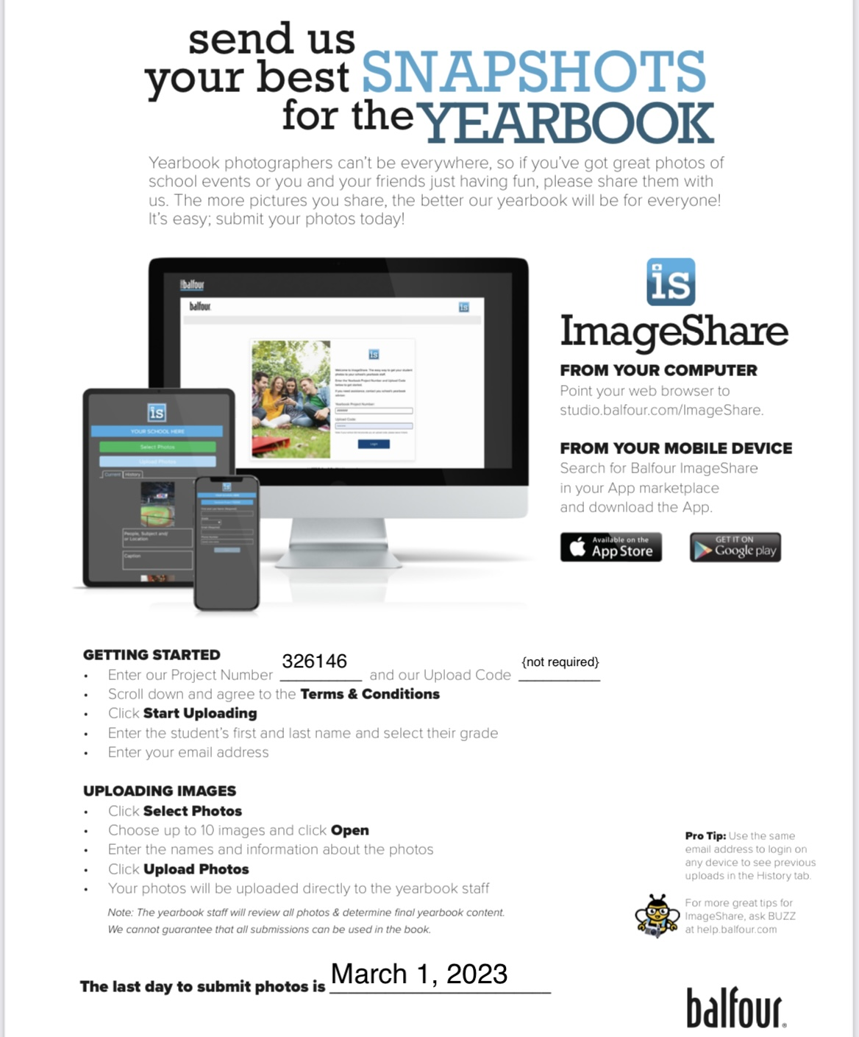

Slide 21
Room parent is a PTA supported role! As room parent, it is important that you join the PTA and encourage the other classroom parents to join the PTA as well! At curriculum night, please encourage parents to join the PTA.
HOW YOU CAN SUPPORT THE PTA & YOUR CHILD…..Donate to the Annual Fund online at: https://dolvinpta.membershiptoolkit.com
WHY BE A SUPPORTER………To enhance YOUR child’s academic and social development.
Dolvin PTA spends appx. $150 per child/per year – your donation directly supports many programs & events.
100% of your donation is tax deductible & goes directly to the students.
WHERE DOES YOUR SUPPORT GO……..Academic Enrichment: Dolvin Discovery Lab, International Day, Lunch Bunch, Reflections, Rock’n Reader, $100 per teacher for school materials, Student Agendas
Student Enrichment: Character Education, Spirit Days, School Store, Book fair, Yearbook, Kids Care, Field Day, All Pro Dad
Social & Hospitality Events: Dolvin Family Fun Night, Bingo Night, Math Night, Ice Cream Social, Teacher Appreciation Week, Class Celebrations
Health & Community Outreach: Grounds & Gardening, Hands On Dolvin, Hearing & Vision Screening, Window of Wishes
And so much more!!!!!! Dolvin Elementary PTA is a 501(c)(3) not-for-profit agency. EIN #58-1406389

Slide 22
QUESTIONS??
Email rtruelove@gmail.com

